Slide 1
Deliverable 3
Permitting Team C
Dima Kazlouski, Aryan Agarwal, Brianna Huang, John Dohyun Kim, Jasper Hoong

Slide 2
Project Motivation, Goal, and Background
Boston's urban landscape is molded by the myriad of building permits granted each year.
Yet, essential questions linger:
What types of permits, characterized by worktype, valuation, and occupancy, dominate the approvals?
How have these trends evolved over the past five years? Beyond the numbers, who are the key players seeking these permits, and what geographical patterns emerge from both the permit requests and the decisions of the zoning board of appeal?
As we venture into this analysis, we also strive to uncover the deeper socio-economic layers, probing into the racial, ethnic, and income profiles of neighborhoods where these permits originate.

Slide 3
Extension project proposal
For our extension proposal, we will look into Voter File for Boston data and conduct analysis in regards to what the voting profile for census tracts where there is a high ratio of approved permits and zoning board of appeal decisions is
Voting is important when concerning approved permits and the zoning board of appeal as zoning regulations are largely determined by the local government and will vary from community to community.
Analyzing this data would show us the correlation between the government and the approval of appeals and whether there are systemic inequalities engrained in municipal politics in permitting
By analyzing the Voter File for Boston data, we hope to find out how the local government affects approvals

Slide 4
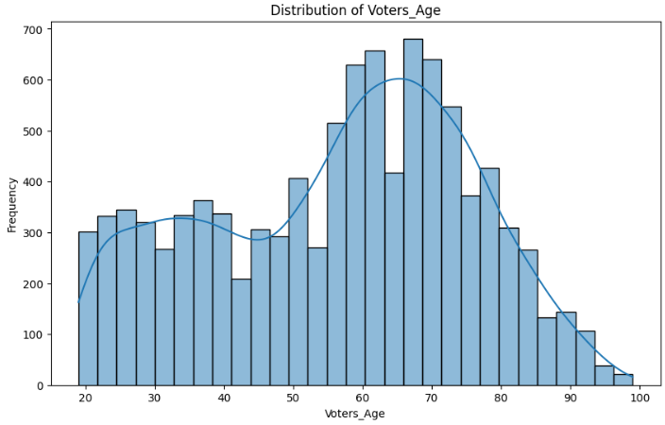
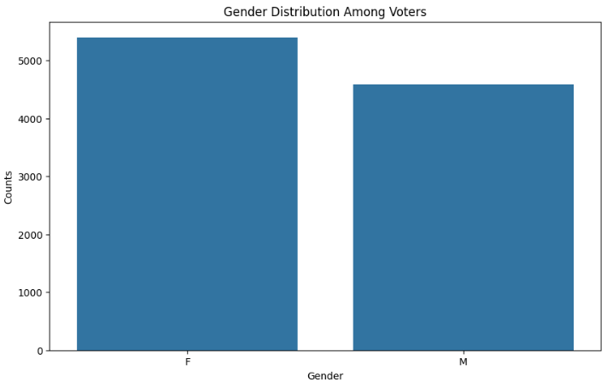
Early Extension Insights

Slide 5
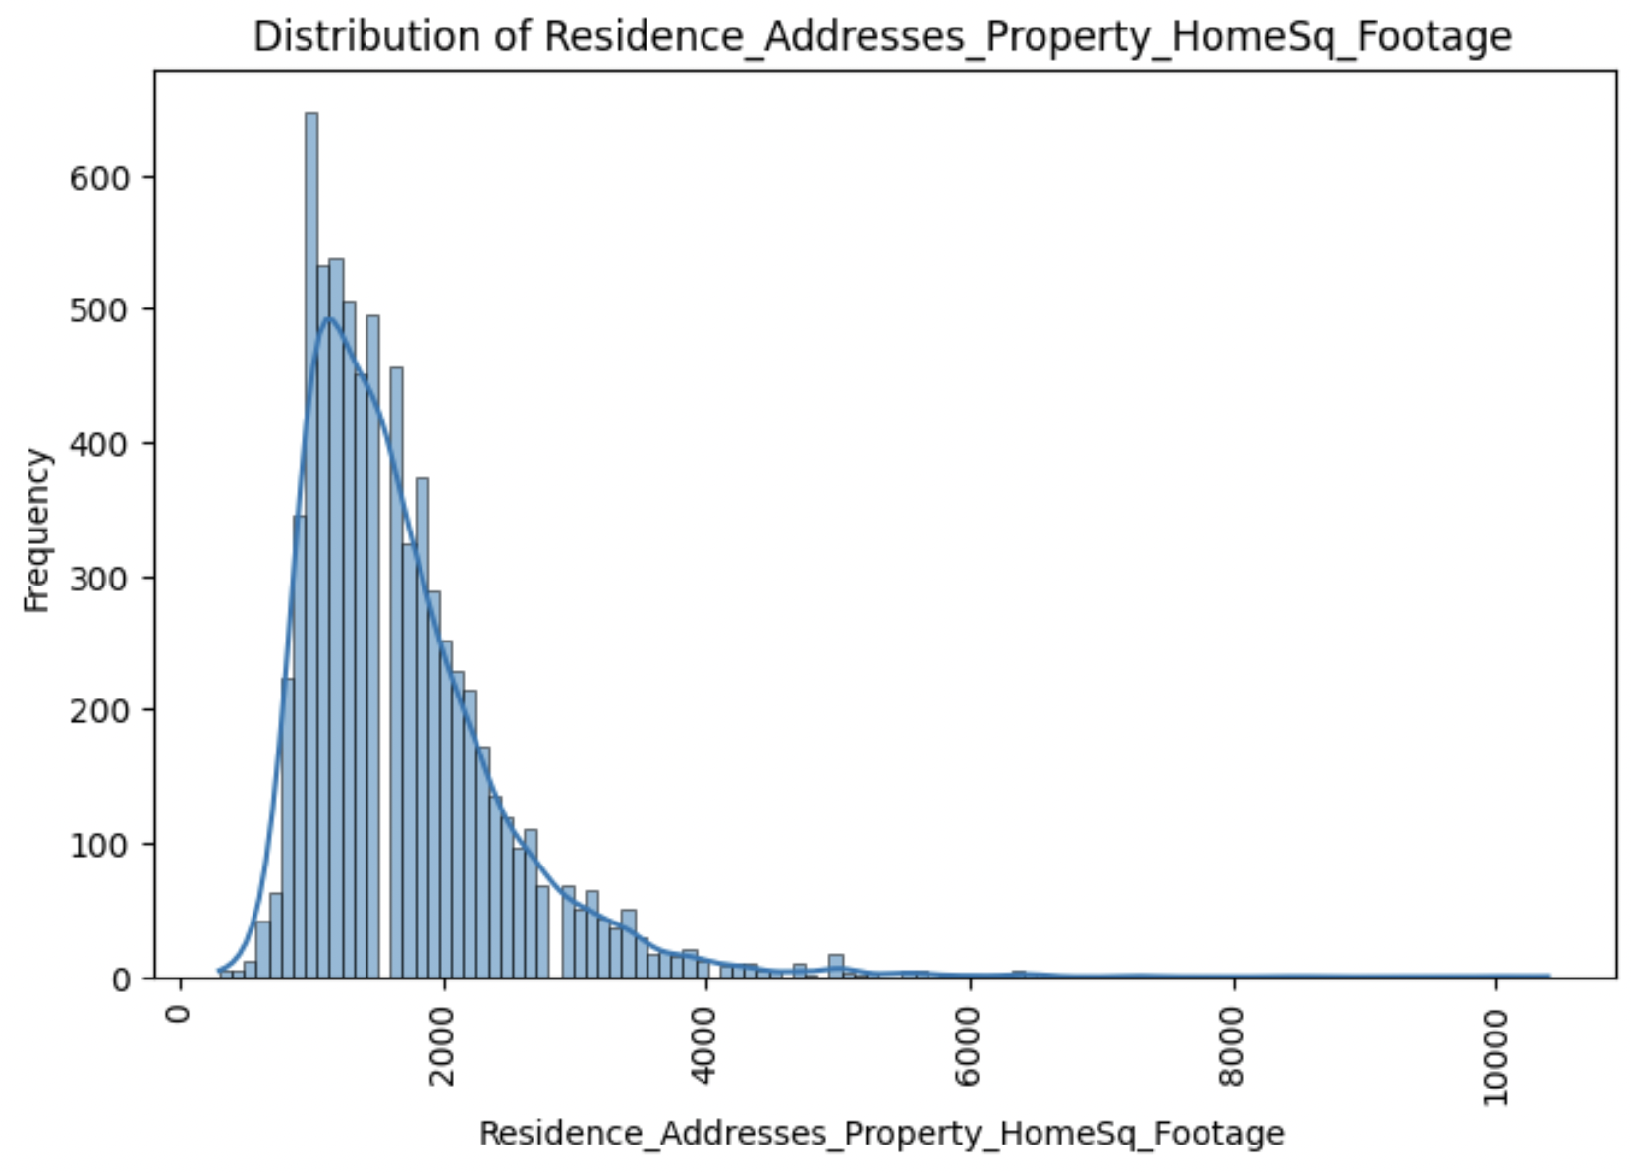
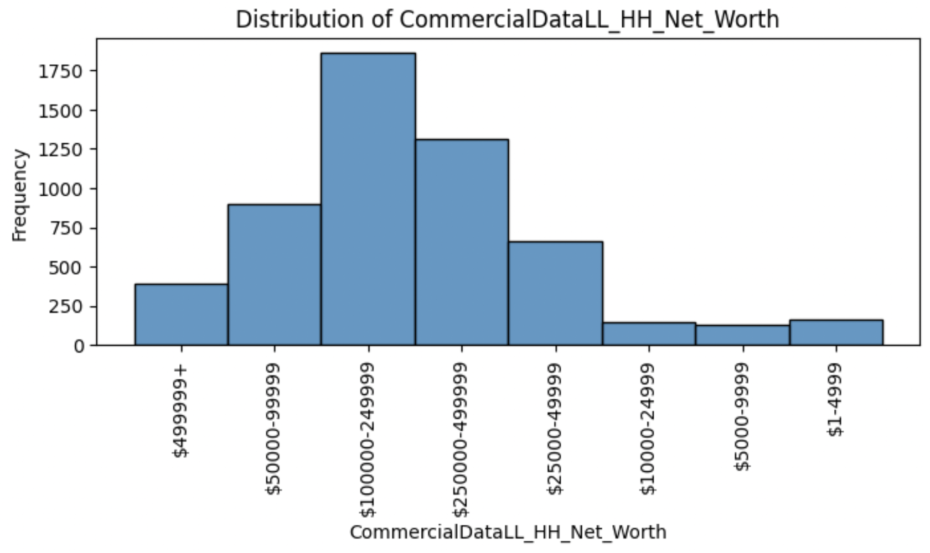
Progress for extension project
Histograms of voters’ household property square footage and net worth

Slide 6
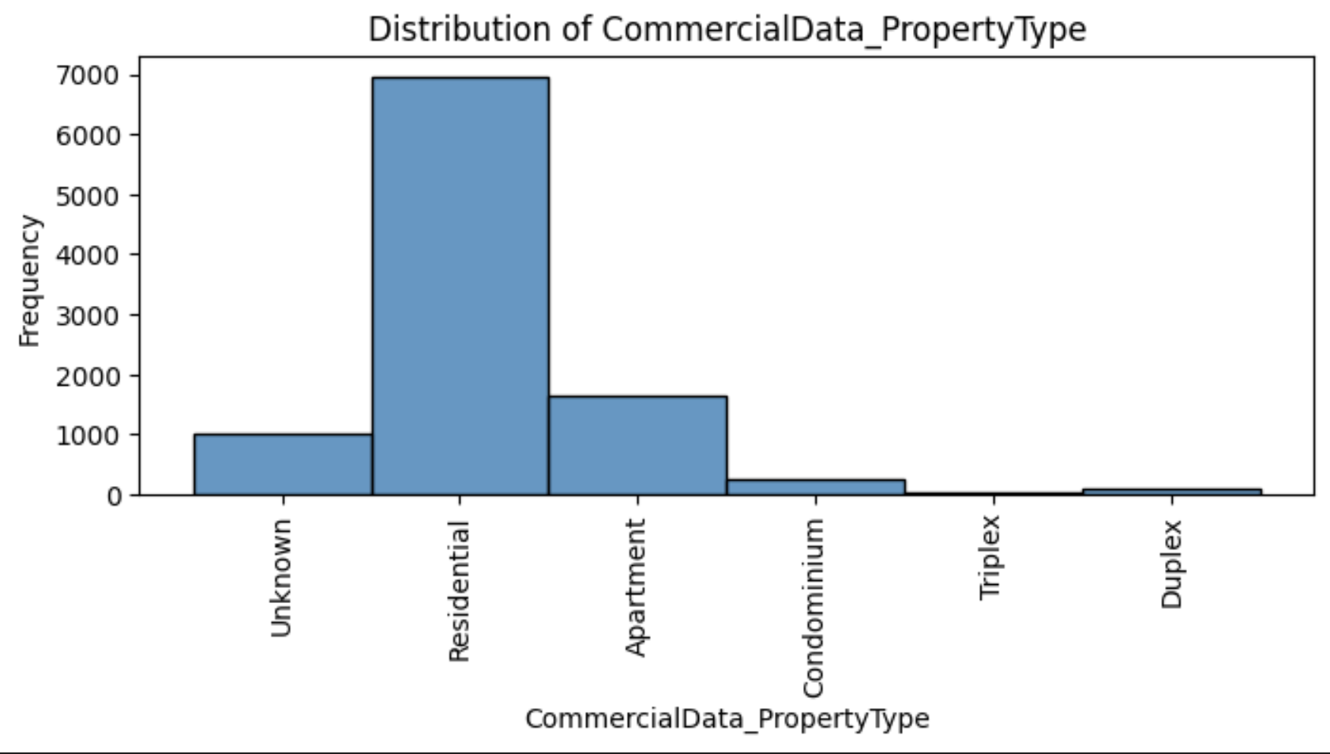
Progress for extension project
Histograms of voters’ property types

Slide 7
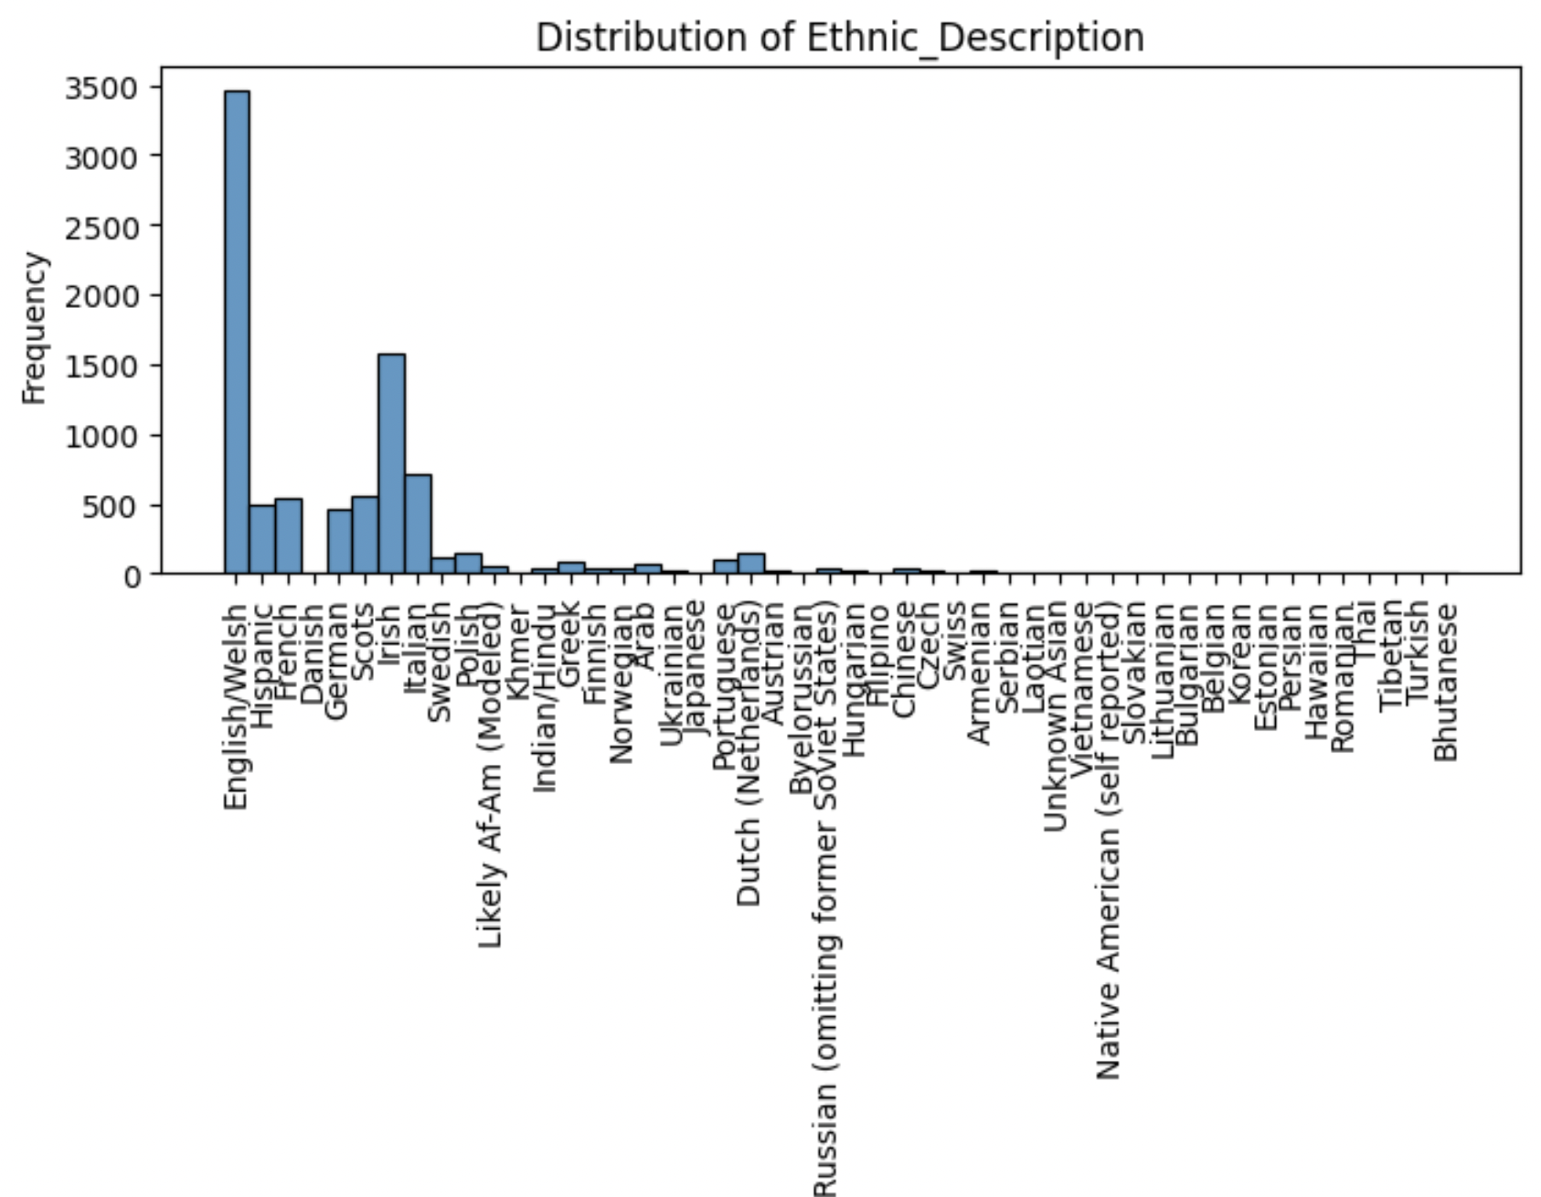
Progress for extension project

Slide 8
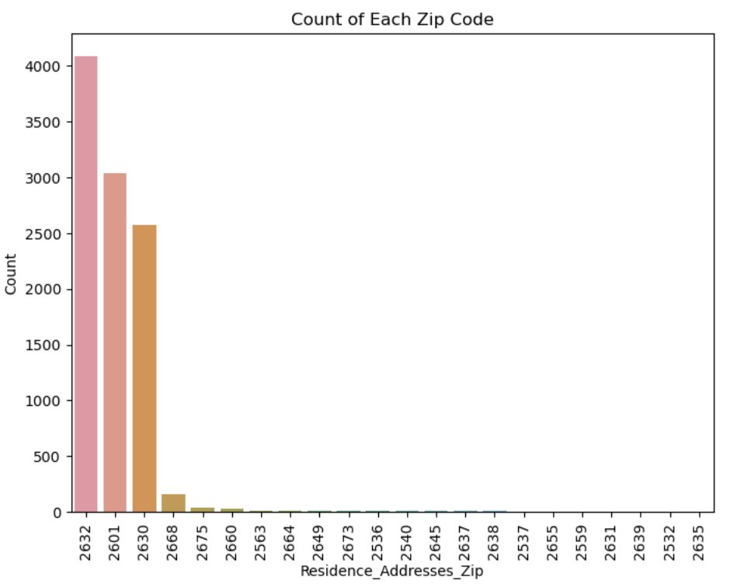
Progress for extension project

Slide 9
Individual Contributions
Dima: Gathered, preprocessed data, and analyzed which questions to dig into for the extension projects.
Aryan: worked on early extension insights
Brianna: conducted EDA to gain insights into voter household property
John: conducted EDA to gain insights into voter ethnic trends
Jasper: conducted EDA to gain insights into voter distribution by zip code.
Everyone: Begun correlating our Voting Data with the analysis that we have done for our permitting and zoning data for our base project to answer the key extension questions.

Slide 10
Thank You

